Slide 1
Liver Disease &
By:
Dr Hadi Mozafari

Slide 2
NORMAL LIVER FUNCTION
The liver is the largest and most complex organ of the gastrointestinal tract.
Overall, it comprises three systems:
First, the biochemical hepatocytic system, which is responsible for all metabolic activities in the body, including protein synthesis (e.g. Albumin & Coagulation Factors); aerobic and anaerobic metabolism of glucose and other sugars; glycogen synthesis and breakdown; amino acid and nucleic acid metabolism; amino acid and dicarboxylic acid interconversions via transaminases (aminotransferases); lipoprotein synthesis and metabolism; xenobiotic metabolism (e.g., drug metabolism), usually involving the cytochrome P₄₅₀ oxidation system; storage of iron and vitamins such as A, D, and B₁₂; and synthesis of hormones such as angiotensinogen, insulin-like growth factor I, and triiodothyronine.
* It is also the site of clearance of many other hormones such as insulin, PTH, estrogens, and cortisol. Uniquely, the liver is the site of metabolism of ammonia to urea.

Slide 3
NORMAL LIVER FUNCTION
The second major hepatic system is the hepatobiliary system, which is concerned with the metabolism of bilirubin, a process that involves transport of bilirubin into the hepatocyte and its conjugation to glucuronic acid and its secretion into bile canaliculi and the enterohepatic system.
Last is the reticuloendothelial system—that is, Kupffer cells. These are a form of macrophage involved:
(a) with the immune system, including being a major site of defense against intestinal bacteria and the primary location for removal of antigen–antibody complexes from the circulation.
(b) with the breakdown of hemoglobin from dead erythrocytes, giving rise to bilirubin, which, together with bilirubin from the spleen, enters the hepatocyte.

Slide 4
METABOLIC FUNCTIONS
Bilirubin
Normal Bilirubin Metabolism
Bilirubin is the major metabolite of heme, the iron-binding tetrapyrrole ring found in hemoglobin, myoglobin, and cytochromes. Approximately 250 to 350mg of bilirubin is produced daily in healthy adults, about 85% of which is derived from turnover of senescent red blood cells.
Bilirubin enters hepatocytes by two mechanisms: passive diffusion and receptor-mediated endocytosis.
Brief metabolism of bilirubin is depicted in next slide:
Notes:
churning : کره سازی

Slide 5
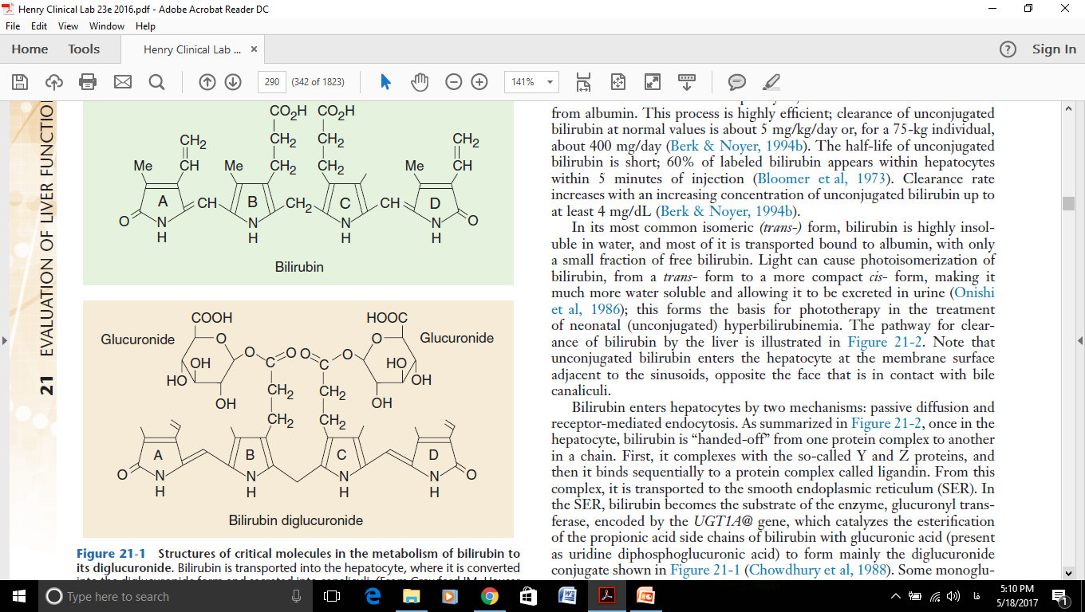
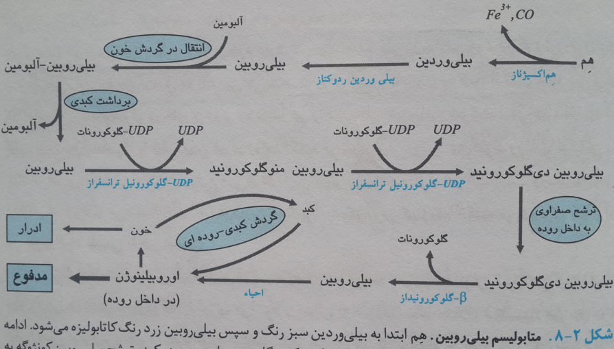
Heme Catabolism
Bilirubin & Urobilinogen
Total Bili(0.2-1.5mg/dI) = indirect Bili( < 0.7mg/dl) + direct Bili( < 0.4mg/dl)
Serumic increase( > 2 mg/dl) leads to Jaundice
NADPH₂

Slide 6
Chronic Hepatitis
Defined as a chronic inflammation of the liver that persists for at least 6 months.
Injury results from an immune-mediated inflammatory attack against the hepatocyte.
Most common causes of chronic hepatitis are chronic HBV and HCV .

Slide 7
Alcoholic Liver Disease
Ethanol is toxic to the liver.
Duration and magnitude of alcohol ingestion (80 gr or 200 ml whiskey/day) and women may be at greater risk because reduced activities of alcohol dehydrogenase.
Is metabolized by liver ADH to acetaldehyde which is subsequently oxidized to acetate by aldehyde dehydrogenase.
acetate acetyl COA lipid biosynthesis

Slide 8
Cirrhosis
Is defined anatomically as diffuse fibrosis with
nodular hepatocyte regeneration.
Cirrhosis consequence of chronic injury to the liver.
The liver’s response to injury, is hepatocyte regeneration and collagen formation.
Then, distorted architecture in the form of nodules and collagen synthesis rate exceeds the degradation rate, cirrhosis results.

Slide 9
Hepatitis A Virus (HAV)
Hepatitis A virus (HAV) is a member of the picornavirus family of RNA viruses.
It is transmitted by the fecal–oral route and typically has an incubation period of 15 to 50 days, with a mean time of about 1 month.
Epidemics or clusters of HAV infection often occur with conditions of poor sanitation, in day care centers, with military actions, and from contaminated food.

Slide 10
Hepatitis B Virus (HBV)
HBV is the most common cause of acute hepatitis, and the most common chronic viral infection.
HBV is transmitted through body fluids, parenteral (vertical transmission) or sexual contact.

Slide 11
Hepatitis C Virus (HCV)
non-A, non-B hepatitis, recognized in 1989 and fully characterized 2 years later.
HCV infection primarily occurs through plasma; the major risk factors are injection drug use and transfusion.

Slide 12
Hepatitis D Virus (Delta Agent)
HDV is an incomplete (RNA particle) that coated with HBsAg and is dependent on HBV for its activation.
It is very infectious and strongly associated with intravenous drug abuse.
It occurs as simultaneous infection with hepatitis B (co-infection) or as superimposed infection in someone with chronic hepatitis B (superinfection).

Slide 14
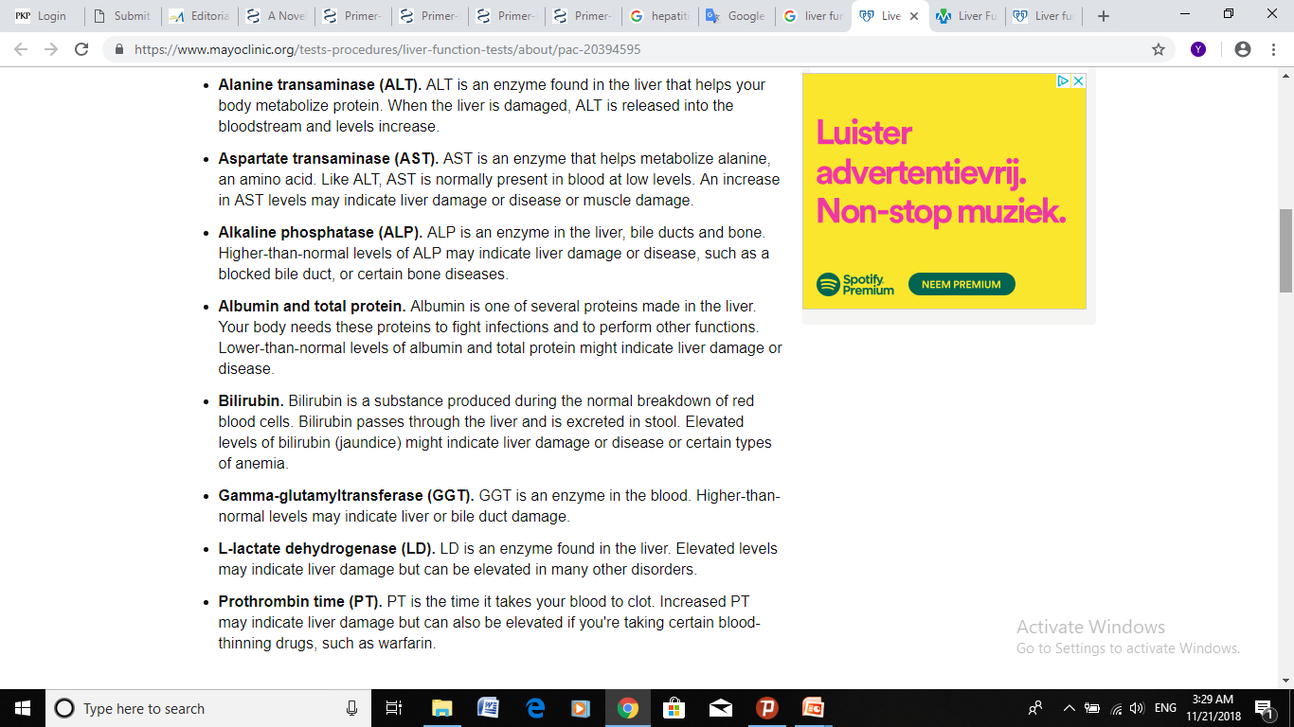
Liver function tests

Slide 15
1- Indirect Hyperbilirubinemia
Due to increasing of RBC destruction & Liver uptake or Conjugation Disorders
Examples: Hemolytic anemia, hemolytic transfusion reaction, Hepatitis & Cirrhosis, Infant physiological jaundice ( leads to Kernicterus with > 20 mg/dl) and even Starvation
I) Gilbert’s syndrome
Is characterized by mild unconjugated hyperbilirubinemia, the most common genetic lesion appears to be the promoter region of the glucuronyl transferase gene, resulting in lower transcriptional rates and overall lower enzymatic activity (reduced to about 30% of normal). Gilbert syndrome is most frequently diagnosed in young adults ranging in age from 20 to 30 years.
II) Crigler-Najjar syndrome
Is frequently characterized by high serum levels of unconjugated bilirubin, multiple mutations are found to occur in this gene (glucuronyl transferase ), including shifts in the reading frames, stop codons, and critical amino acid substitutions.
always exceeding 5mg/dL and causing jaundice, and sometimes exceeding 20mg/dL.

Slide 16
Indirect Hyperbilirubinemia (cont’d)
- Affected infants develop severe unconjugated hyperbilirubinemia, which typically leads to kernicterus, deposition of bilirubin in the brain causing severe motor dysfunction
and retardation.
In the less severe type II form of Crigler-Najjar syndrome, enzyme activity is approximately 10% of normal, and survival to adulthood is possible.
Treatments for Infants with Indirect Hyperbilirubinemia:
Phototherapy with Wavelength 450nm (Light can cause photoisomerization of bilirubin, from a trans- form to a more compact cis- form, making it much more water soluble and allowing it to be excreted in urine)
Prescription of Phenobarbital
Blood Transfusion

Slide 17
2- Direct Hyperbilirubinemia
Causes:
Generally, It occurs in Cholestasis due to Gallstones or Tumors with clay-colored (Pale) stool. It also observed in Hepatitis, Liver Cirrhosis, Inflammatory conditions of the biliary tract and gram- negative sepsis.
I) Dubin-Johnson syndrome.
In another inborn error of metabolism, called the Dubin-Johnson syndrome, there is a blockade of the excretion of bilirubin into the canaliculi, caused by defects in the adenosine triphosphate (ATP)-binding cassette (ABC) canalicular multispecific organic anion transporter.
Dubin-Johnson syndrome is associated with increased plasma conjugated bilirubin, typically with mild jaundice (total bilirubin, 2 to 5mg/dL).
II) Biliary obstruction
In adults, cholelithiasis is the most common cause of hyperbilirubinemia. This condition results from the presence of bile stones (that are composed of bilirubin or cholesterol), most commonly in the common bile duct .
Biliary obstruction due to cholelithiasis results in elevation of total bilirubin, with over 90% being direct bilirubin. In more than 90% of such patients, a concomitant rise in alkaline phosphatase occurs.
Notes:
canalicular multispecific organic anion transporter. ترانسپورتر مجاری چند آنیونی

Slide 18
Direct Hyperbilirubinemia (cont’d)
III) Hepatitis
In hepatitis, in which toxic destruction of hepatocytes is due to viral, chemical, or traumatic causes, focal necrosis and/or cellular injury results both in blocking conjugation of bilirubin and in excretion of conjugated bilirubin. Thus elevation of both direct and indirect bilirubin occurs.
Laboratory Tests for Bilirubin
Bilirubin is typically measured using diazotized sulfanilic acid, which forms a conjugated azo compound with the porphyrin rings of bilirubin, resulting in reaction products that absorb strongly at 540nm. Because unconjugated bilirubin reacts slowly, accelerants such as caffeine or methanol are used to measure total bilirubin. Deletion of these accelerants allows determination of direct-reacting, or direct, bilirubin.
Prolonged exposure to light causes photoisomerization, increasing direct reacting bilirubin
Reference values for total bilirubin are both age and gender (higher in men) dependent. Bilirubin levels typically reach peak values at around ages 14 to 18, falling to stable adult levels by age 25.
Notes:
Focal: کانونی، مرکزی

Slide 19
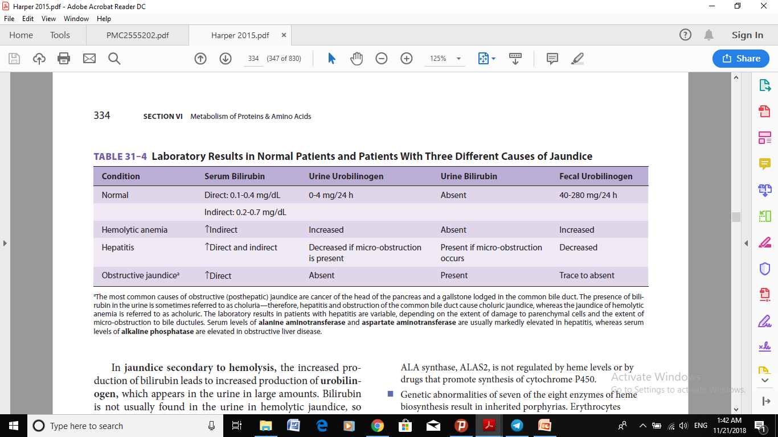

Slide 20
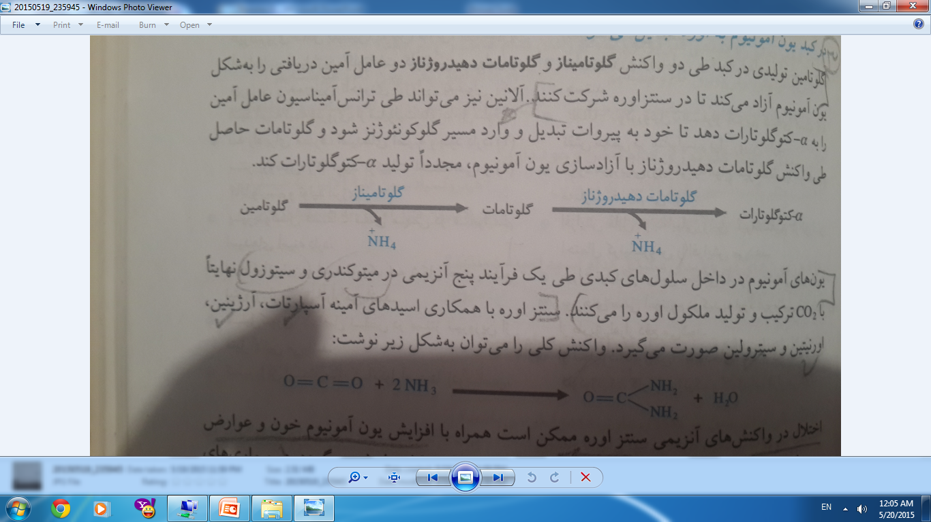
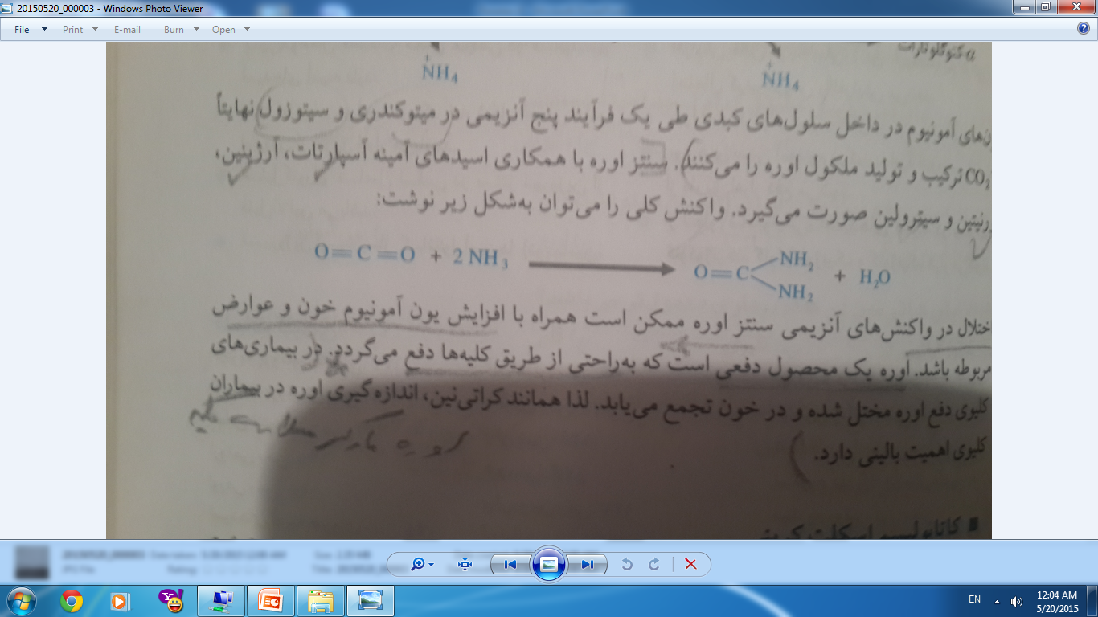
Other Metabolic Tests
Ammonia
This critical and toxic compound is metabolized exclusively in the liver.
Ammonia is derived mainly from amino acid and nucleic acid metabolism.
In Liver:
Other Tissues
Urea

Slide 21
Ammonia (Cont’d)
If most of the liver is destroyed as a result of such conditions as cirrhosis or, less commonly, acute fulminant hepatic failure, including Reye’s syndrome, urea cycle enzymes are no longer present, resulting in the toxic buildup of ammonia and some of the amino acid intermediates in the urea cycle, such as arginine, which has known neurotoxic effects giving rise to hepatic encephalopathy.
An important mechanism by which ammonia can cause toxicity to the CNS is its ability to lower the concentration of γ-aminobutyric acid (GABA).
Assays for Ammonia:
Ammonia is typically measured by enzymatic assays using glutamate dehydrogenase, which catalyzes the reaction of α-ketoglutarate and ammonia to form glutamate, with oxidation of NADPH to NADP as the indicator (decrease in absorbance at 340nm).
Arterial blood is the preferred specimen for measurement of ammonia. Although venous blood is not recommended, if used, tourniquets should be used minimally during collection. Specimens should be kept in ice water until separation of cells from plasma occurs.

Slide 22
Lipids
Cholesterol and Other Lipids
Because the liver is vital in lipoprotein synthesis and interconversions, hepatic disorders often cause derangements in lipoprotein metabolism.
In severe liver injury, including cirrhosis, these abnormalities include a decrease in high-density lipoprotein (HDL), deficiencies of lecithin/cholesterol acyltransferase (LCAT, the enzyme that esterifies cholesterol) and of lipoprotein lipases, resulting in elevated levels of unesterified cholesterol and hypertriglyceridemia (triglyceride levels ranging from 250 to 500mg/dL), respectively.
Bile Salts
They are not usually used in the diagnosis of abnormal liver function but are important in that they constitute a substantial amount of bile in bilirubin excretion and can therefore be of use in diagnosing cholestasis.
Bile salts can be measured by many techniques, but chromatographic methods, particularly high-performance liquid chromatography are most widely used

Slide 23
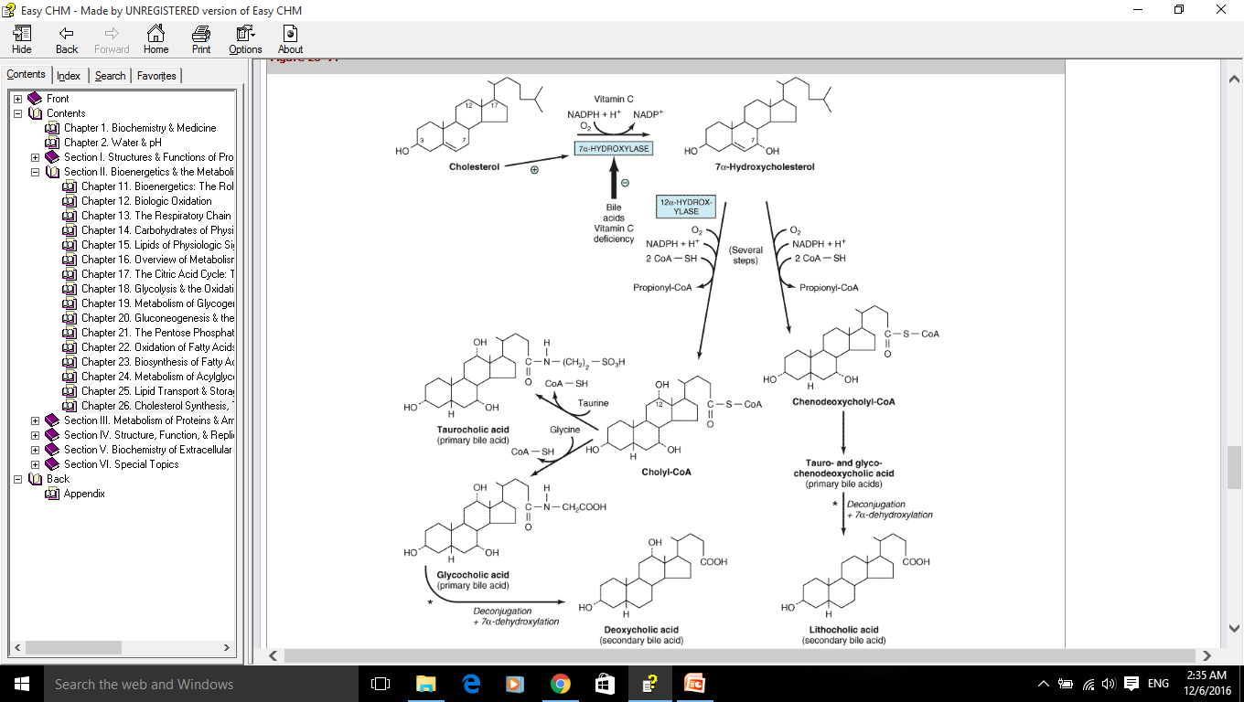
Cholesterol Is Excreted from the Body in the Bile as Cholesterol or Bile Acids (Salts)

Slide 24
- SYNTHETIC FUNCTIONS
Protein Synthesis
The liver is the site of synthesis for most plasma proteins. Major exceptions include immunoglobulins (Igs) and von Willebrand factor. Synthesis of more than 90% of all protein and 100% of albumin occurs in the liver. Thus extensive destruction of liver tissue will result in low serum levels of total protein and albumin.
In liver disease with widespread injury or necrosis, such as fulminant hepatic failure and cirrhosis, plasma levels of liver-synthesized proteins fall, such that proteins with longer half-lives tend to decrease more slowly.
Albumin has a half-life of about 20 days.
Determination of Serum Protein Levels
This is based usually on the Biuret method.
This method reflects the ability of the peptide backbone C = O groups of proteins to form color complexes with copper that absorb strongly at 540nm.
Some methods utilize a dye-binding method in which the proteins form a complex with the dye Coomassie blue.
Albumin forms a unique color complex with the dyes bromcresol green and bromcresol purple.
The reference range for total serum protein levels is generally in the 6 to 7.8 g/dL range. At least 60% of this should be albumin, the normal range for which is about 3.5 to 5g/dL.

Slide 25
Albumin
Albumin is the major protein produced by the liver. Its synthesis is increased by low plasma oncotic pressure and is decreased by cytokines, particularly interleukin-6.
A decrease in albumin is one of the major prognostic features in patients with cirrhosis. Albumin is a transport protein for many substances, both endogenous (e.g., bilirubin, thyroid hormone) and exogenous (e.g., drugs).
Low serum albumin levels due to liver disease are almost always caused by massive destruction of liver tissue and are seen primarily in cirrhosis, most often secondary to alcoholism. The diminution in albumin is paralleled by a fall in total serum protein. Because albumin is the osmotically active intravascular colloid, hypoalbuminemia often results in edema.
Other Serum Proteins
1- α-1-Antitrypsin
α-1-antitrypsin (AAT), the most abundant α-1-globulin, is the most important protease inhibitor in plasma. Although its name indicates that it inhibits trypsin, it also is an inhibitor of other serine proteases, such as elastin.
Some mutations prevent normal protein glycation, leading to accumulation of AAT within hepatocytes and reduced plasma AAT levels and causes liver injury.

Slide 26
2- Ceruloplasmin
The major copper-containing protein in serum, ceruloplasmin is also the enzyme present in highest circulating concentration. Ceruloplasmin is a ferroxidase, which is essential for converting iron to the ferric state to allow binding to transferrin. Low levels of ceruloplasmin are found in Wilson’s disease, a rare congenital disorder (1 in 30,000 individuals) associated with mutations in ATP7B, a member of the cation-transporting p-type ATPase family.
This protein is principally expressed in the liver and promotes copper secretion into plasma, coupled with ceruloplasmin synthesis, and into the biliary tract.
Resultant liver damage can lead to chronic active hepatitis, cirrhosis, or, uncommonly, fulminant hepatic failure. In addition, steatosis and inflammation can result in this condition. Copper becomes deposited in the CNS, especially in the lenticular nucleus of the basal ganglia, causing neuropsychiatric disease; it can also be deposited at the edge of the iris, forming the observed Keyser-Fleischer rings.
The diagnosis of Wilson’s disease is including low serum ceruloplasmin, which can be measured by immunoassay or by enzymatic assay, increased urinary copper excretion, and increased hepatic copper content.
Notes:
Steatosis (also called fatty change, fatty degeneration, or adipose degeneration) is the process describing the abnormal retention of lipids within a cell. چرب شدن و نفوذ چربی به سلول کبد
Basal Ganglia: a group of structures linked to the thalamus in the base of the brain and involved in coordination of movement.

Slide 27
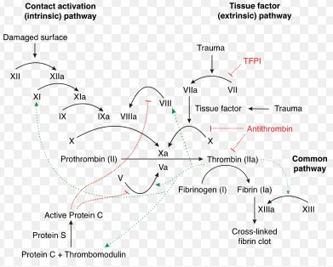
Clotting Factors
As mentioned earlier, except for the von Willebrand factor, which is made by endothelial cells and megakaryocytes, coagulation proteins are synthesized in the liver.
Inhibitors of coagulation, such as antithrombin III, α-2-macroglobulin, α-1-antitrypsin, C1 esterase inhibitor, and protein C, are synthesized in the liver.
Low levels of antithrombin III in patients with cirrhosis and hepatitis may be caused by decreased synthesis, increased consumption, or alteration in the transcapillary flux ratio.
The most common coagulopathy seen in liver failure (i.e., cirrhosis and acute fulminant hepatic failure) is disseminated intravascular coagulopathy (DIC). This condition is characterized by increased consumption of clotting factors and platelets, causing thrombocytopenia and elevations of both prothrombin and partial thromboplastin times, PT and PTT, respectively.
Notes:
C1-inhibitor (C1-inh, C1 esterase inhibitor) is a protease inhibitorbelonging to the serpin superfamily. Its main function is theinhibition of the complement system to prevent spontaneous activation. C1-inhibitor also inhibits proteases of the fibrinolytic, clotting, and kinin pathways. Note that C1-inhibitor is the most important physiological inhibitor of plasma kallikrein, fXIa, and fXIIa.
انعقاد درونرگی منتشر (به انگلیسی: Disseminated intravascular coagulation) یا (به انگلیسی: DIC) یا اختلال انعقادی منتشر که به‌معنی فعال‌شدن سیستم انعقاد خون به‌صورت منتشر در رگ‌های مختلف بدن است. حالتی خطرناک و کشنده‌است که به‌دلایل مختلفی مانند سرطان، بیماری‌های زنان، عفونت، مسمومیت و مارگزیدگی رخ می‌دهد.
در انعقاد درون‌رگی منتشر به دنبال فعال شدن گسترده روند انعقاد خون نتیجه آن تشکیل فیبرین درون‌رگی و در نهایت انسداد ترومبوزی عروق کوچک و متوسط است . انعقاد درون رگی همچنین می‌تواند جریان خون ارگان‌ها را مختل و ممکن است در ایجاد نارسایی ارگان‌های متعدد شرکت نماید. همزمان مصرف پلاکت‌ها و پروتئین‌های انعقادی باعث کاهش آنها در پلاسما شده و امکان دارد که منجر به خونریزی شدید شود.در یک بیمار مبتلا به انعقاد درون‌رگی منتشر خونریزی، شوک و نارسایی چند ارگانی ممکن است از نشانه‌های موجود باشند .

Slide 28
TESTS OF LIVER INJURY
Plasma enzymes
Functional enzymes
  perform a physiological function in the blood
  present at all times in the circulation
  lipoprotein lipase, proenzymes of blood coagulation
Non functional enzymes
  have no physiological function in the blood
  majority of enzymes is frequently absent from plasma
  normally intracellular enzyme, low levels of these enzyme in plasma.
  Elevated levels are indicator of tissue damage, this is why they are used in clinical diagnosis.

Slide 29
Normal cell turnover
Cell necrosis as a result of a disease or trauma

Slide 30
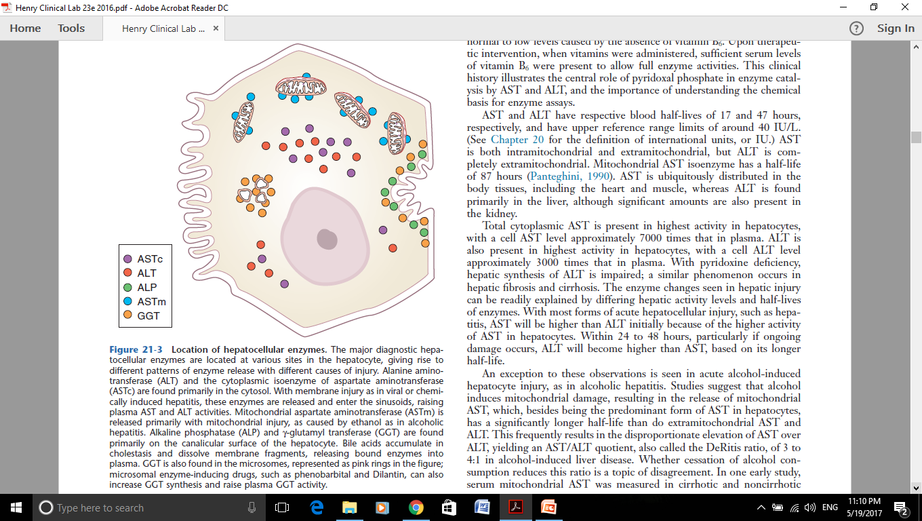
Cellular Locations of Enzymes
Cytoplasmic enzymes include lactate dehydrogenase (LD), aspartate aminotransferase (AST), and alanine aminotransferase (ALT).
Mitochondrial enzymes, such as the mitochondrial isoenzyme of AST, are released with mitochondrial damage.
Canalicular enzymes, such as alkaline phosphatase and γ-glutamyl transferase (GGT), are increased by obstructive processes.

Slide 31
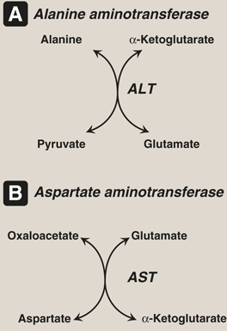
1- Aminotransferases (Transaminases): ALT & AST
AST is ubiquitously distributed in the body tissues, including the heart and muscle, whereas ALT is found primarily in the liver, although significant amounts are also present in the kidney.
Total cytoplasmic AST is present in highest activity in hepatocytes, with a cell AST level approximately 7000 times that in plasma. ALT is also present in highest activity in hepatocytes, with a cell ALT level approximately 3000 times that in plasma. With pyridoxine deficiency, hepatic synthesis of ALT is impaired.
In alcoholic hepatitis because, both enzymes become significantly elevated such that AST levels are higher than those for ALT.
Also, AST has a index role in hepatotoxic drug using and monitoring. Three fold increase in AST activity is an indicator for STOP.
B₆PO4
B₆PO4

Slide 32
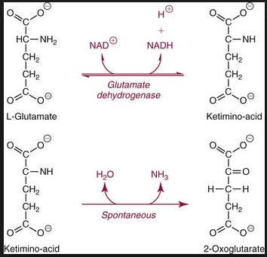
1- Aminotransferases (Cont’d)
With most forms of acute hepatocellular injury, such as hepatitis, AST will be higher than ALT initially because of the higher activity of AST in hepatocytes. Within 24 to 48 hours, particularly if ongoing damage occurs, ALT will become higher than AST, based on its longer half-life.
In chronic hepatocyte injury, mainly in cirrhosis, ALT is more commonly elevated than AST; however, as fibrosis progresses, ALT activities typically decline, and the ratio of AST to ALT gradually increases, so by the time cirrhosis is present, AST is often higher than ALT.
Assays for AST and ALT
Alanine for ALT or aspartate for AST is added to force the reaction to the right, yielding glutamate. Production of the latter is then coupled to the enzyme glutamate dehydrogenase, in the so-called indicator reaction, yielding α-ketoglutarate. In this reaction, nicotinamide adenine dinucleotide (NAD) is converted to NADH (reducing agent derived from NAD), which can be measured as an increase in absorbance at 340nm.
OD at 340nm

Slide 33
Aminotransferases in Viral hepatitis
In hepatitis A, increased levels of both enzyme occurs after IgM anti-HAV detection.
In hepatitis B, increased ALT/AST activity (usually more than 200-500IU/L) is associated with IgM anti HBc detection.
In hepatitic C, in about 50% of patients, only increase of ALT activity is detectable.

Slide 34
Note-Liver Cell Damage
Generally, some causes including: infectious hepatitis, toxins or drugs (Alcohol & Acetaminophen), and hypoxia trauma etc leads to liver cell damages.
1- Steady increase of enzyme activities shows development of chronic liver disease.
2- Sudden decrease of high levels enzyme activity shows serious liver cell damages.

Slide 35
2- Lactate Dehydrogenase
this cytosolic glycolytic enzyme catalyzes the reversible oxidation of lactate to pyruvate.
Five major LD isozymes exist, consisting of tetramers of two forms, H and M.Progressing from HHHH to MMMM, the five possible isozymes are labeled LD1 to LD5.
LD1 and LD2 predominate in cardiac muscle, kidney, and erythrocytes.
LD4 and LD5 are the major isoenzymes in liver and skeletal muscle.
The upper reference range limit for total LD activity in serum is around 150 IU/L. Serum LD levels become elevated in hepatitis; often, these increases are transient and return to normal by the time of clinical presentation.
An increase in LD more than 500 IU/L associated with increased ALP (>250IU/L) without aminotransferases change is an indicator for Metastatic Carcinoma, Primary HCC and rarely, hemangioma.
Notes:
همانژیوم کبدی توده‌ای خوش‌خیم و غیرسرطانی در کبد است که از کلافه‌ای در هم پیچیده از عروق تشکیل می‌شود.

Slide 36
Enzymes Primarily Reflecting Canalicular Injury
- These enzymes are located predominantly on the canalicular membrane of the hepatocyte and include alkaline phosphatase, γ-glutamyl transferase, and 5′-nucleotidase. In contrast to cytoplasmic enzyme activities, canalicular enzyme activities within hepatocytes are typically quite low.
Alkaline Phosphatase
ALP is present in a number of tissues, including liver, bone, kidney, intestine, and placenta, each of which contains distinct isozymes that can be separated from one another by electrophoresis.
ALP is a marker for biliary dysfunction.
In obstruction of the biliary tract by stones in the ducts or ductules, or by infectious processes resulting in ascending cholangitis, or by space occupying lesions, biliary tract ALP rises rapidly to values sometimes in excess of 10 times the upper limit of normal.
γ-Glutamyl Transferase
- Its major use is to discriminate the source of elevated ALP (i.e., if ALP is elevated and GGT is correspondingly elevated, then the source of the elevated ALP is most likely the biliary tract). The highest values, often greater than 10 times the upper limit of normal, may be found in chronic cholestasis due to primary biliary cirrhosis or sclerosing cholangitis.
Notes:
sclerosing cholangitis التهاب مجاری صفراوی: لتهاب مجاری صفراوی ناشی است از سنگ کلدوک (سنگ در مجاری صفراوی مشترک) که صفرا را از کیسه صفرا به روده باریک انتقال می‌دهند. این بیماری اغلب ناشی از سنگ کیسه صفرا (کله لیتیاز) بوده و همراه با کله سیستیت (التهاب کیسه صفرا) می‌باشد. علائم این بیماری در اینگونه موارد مشابه کلسیستیت بوده و به دو شکل مزمن (کولیک صفراوی) و حاد (کلانژیت صعودی) دیده می‌شود.
در کلانژیت به خصوص فرم حاد ما عفونت باکتریایی مجاری صفراوی را داریم شایع‌ترین ارگانیسم‌های ایجاد کننده باکتری‌های هوازی گرم منفیروده‌ای مثل ای کلای، کلبسیلا، کلوستریدیوم، باکتروئید‌ها، آنتروباک‌تر و استرپتوکوک‌های گروه DD هستند.
سپسیس در سیر بیماری کلانژیت یک یافته غالب می‌باشد بنابراین ارزیابی تشخیصی و مداخله سریع در این بیماری ضروری است.

Slide 37
Note- Biliary obstruction
Occurs due to: Pancreas tumor, some drugs, infectious diseases.
High ALP activity is main diagnostic biomarker. Long-term biliary obstruction is associated with increased PT and even direct bilirubin or cholesterol.

Slide 38
α-FETOPROTEIN
α-Fetoprotein (AFP) is synthesized by embryonic hepatocytes and fetal yolk sac cells and peaks in the second trimester of pregnancy, reaching levels that constitute up to one-third of fetal serum protein.
AFP becomes elevated to abnormal levels in fetal neural tube deficits.
After acute hepatic injury, a rise in AFP (typically 100 to 200 ng/dL) from regenerating hepatocytes usually occurs.
AFP has been found to be an important marker for hepatocellular carcinoma (HCC). Elevated levels can also occur after acute liver disease and fibrosis, making this marker somewhat nonspecific.
At levels greater than 400 ng/dL, there is a high probability of HCC, but at these levels of AFP, the tumor is widespread, so its use as an early detector of HCC is limited.
In HCC, it is possible to increase AST with normal levels of ALT.
Recently, some studies had been reported that Des-gamma-carboxy prothrombin (DCP), an abnormal form of prothrombin, is increased in HCC and has a prognosis role.

Slide 39
DIAGNOSIS OF LIVER DISEASES
It is important to remember that in acute hepatitis (due to different viral hepatitis, drugs and toxins), the principal changes include significant elevations of aminotransferases (ALT>AST). Total bilirubin (including both types) are increased dramatically. PT is increased with decreased Albumin.
- Generally, in viral hepatitis, ALT, AST, LDH (up to 300-500 IU/L), ALP (up to 200-350 IU/L) activities, bilirubin and gamaglobulins are increased. However, total protein and albumin remains in normal range.
In Alcoholic hepatitis, ASTm, ALT and GGT activity is increased. Possibly, Uric acid and TG are increased. However, total protein and albumin remains in normal range.
In cirrhosis, ALT/AST and LDH tend to remain normal or become slightly elevated (at first ALT>AST-then, AST>ALT), while total protein and albumin are depressed. Both bilirubin and ammonia (positive correlated with Encephalopathy severity) concentrations in serum are elevated. Also, hypergammaglobulinemia (IgG & IgA) is observed. Both PT and PTT are increased.
Notes:
Viral hepatitis may lead to hepatic failure. Hepatitis A and B account for most of these cases. In the developing world, acute hepatitis B virus (HBV) infection dominates as a cause of fulminant hepatic failure because of the high prevalence of the disease. Hepatitis C rarely causes acute liver failure.

Slide 40
DIAGNOSIS OF LIVER DISEASES
In posthepatic biliary obstruction, bilirubin and alkaline phosphatase become elevated; in space-occupying diseases of the liver, ALP and LDH are elevated.
In fulminant hepatic failure, Within a week, the severe increase of aminotransferases (ALT<AST) and ammonia occurs, but total protein and albumin are depressed. Also, due to liver insufficiency hypernatremia & hypokalemia occurs.
- In addition, LDH & ALP activity and Bilirubin concentrations are increased.
Notes:
Viral hepatitis may lead to hepatic failure. Hepatitis A and B account for most of these cases. In the developing world, acute hepatitis B virus (HBV) infection dominates as a cause of fulminant hepatic failure because of the high prevalence of the disease. Hepatitis C rarely causes acute liver failure.

Slide 42
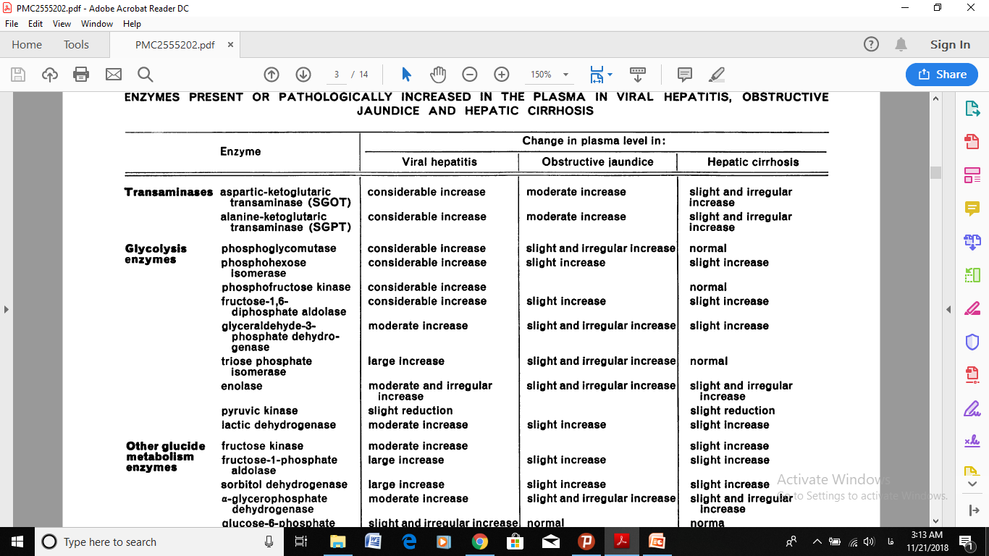

Slide 43
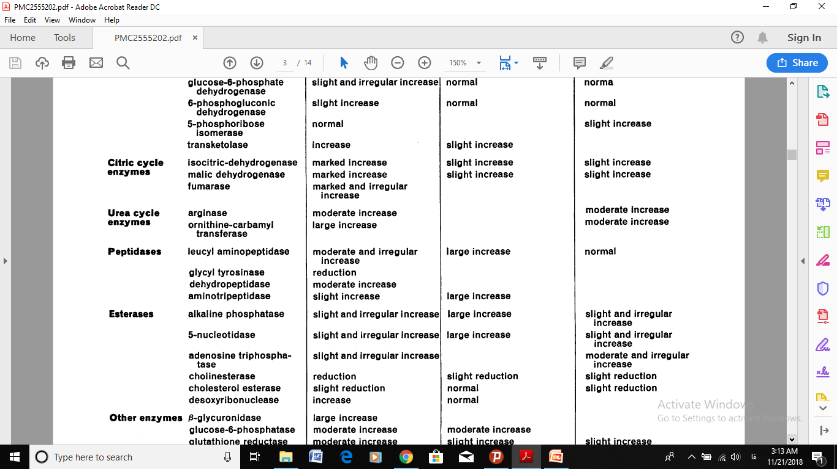

Slide 44
Thank you

