Slide 1
Hematology specimen acceptability
Dr Ali Maleki PhD in Lab Hematology & Transfusion Sciences
Clinical Lab Sciences Department
School of Paramedical Sciences
Kermanshah University of Medical Sciences
Ali.maleki@kums.ac.ir

Slide 2
Hematology specimen acceptability

Slide 4
Intoduction
Although Lab medicine seems overall less vulnerable to mistakes than other clinical and diagnostic areas  the chance of errors is still not negligible and may generate adverse consequences on both the quality of testing and patient safety.
Lab errors in total testing process (TTP):
preanalytical errors → the majority of the total errors (46 - 68%) in Lab medicine  mainly emerging from manually intensive activities (collection, handling, transportation, preparation and storage of specimens)
errors occur in the analytical (7 - 13%)
errors occur in the postanalytical (18 -47%) phase
Laboratories usually establish a guideline for evaluating the acceptance of specimens  specimens not meeting the criteria of acceptability are rejected.

Slide 5
Intoduction
Preanalytical errors  start at the point of test requests by clinicians
Studies showed that → the main rejection reasons for hematology specimens were clotted samples and insufficient specimen quantity (5,10).
Personal impact on specimen collection was an important factor
preanalytical error rate was 2-4 times higher for non-Lab phlebotomists than Lab staff (4).
The aim of this study was → to determine:
the frequency and reasons for rejected hematology specimens,
preanalytical variables which may affect specimen quality, and
consequences of rejection,
provide suggestions on monitoring quality indicators as to obtain a quality improvement.

Slide 6
Materials and methods
A cross-sectional survey was conducted and a questionnaire was sent to 1586 Labs.
Participants were asked to provide general information about institution and practices on specimen management and record rejections and reasons for rejection from 1st to 31st July.
The questionnaire was divided into 2 parts:
The first part contained 18 questions on institution characteristics and Lab practices on collection, transportation, and specimen handling.
The second part comprised information about hematology specimen acceptability

Slide 7
Materials and methods
For each rejected specimen, the following information had to be recorded:
source department,
container type,
container material type,
transportation method,
phlebotomy personnel,
reason for rejection,
action taken
time (including time of specimen receipt, time of specimen rejection and time of specimen recollected or relabelled).

Slide 8
Materials and methods
Participants also provided the:
total number of hematology specimens (both acceptable for testing and rejected)
the total number of specimens by source department,
container type,
container material type,
transportation method
phlebotomy personnel

Slide 9
Statistical analysis
Excel (2007 version) and SPSS 20.0 were used to analyse collected data.
The overall rejection rate and interLab rejection rate were calculated
Percentage (%) and sigma value (σ) were employed  to evaluate the status of rejection rate
The characteristics and practices of institutions were considered and participants were grouped according to them.
The Odds ratio (OR) was calculated, for each level
Nonparametric Kruskal-Wallis test for ≥ 3 groups and Mann-Whitney U test for 2 groups were performed to compare the interLab rejection rate
Significance was defined as probability, P-value＜0.05.

Slide 10
Results
A total of 1586 questionnaires were sent → 890 (56%) questionnaires were returned
According to exclusion criteria → 580 questionnaires were considered valid and included in further analysis.
Most of participants (69%) were general hospitals and 15% were specialized hospitals.

Slide 11
Results
Nurse managed by nursing department was the most frequent phlebotomy personnel in:
inpatient department (97%) and
emergency department (72%)
for outpatient department, the common phlebotomy personnel were:
nurse managed by nursing department (39%),
Lab personnel (34%) and
nurse managed by clinical Lab (26%)

Slide 12
Results
Common specimen transportation methods were by:
in inpatient department → full-time transportation worker (67%) and nurse (12%)
in outpatient department → full-time transportation worker (32%) and Lab personnel (44%)
in emergency department → full-time transportation worker (45%) and nurse (22%)

Slide 13
①
②
①
②
②
①

Slide 14
①
②
①
②

Slide 15
①
②
①
②
①
②

Slide 16
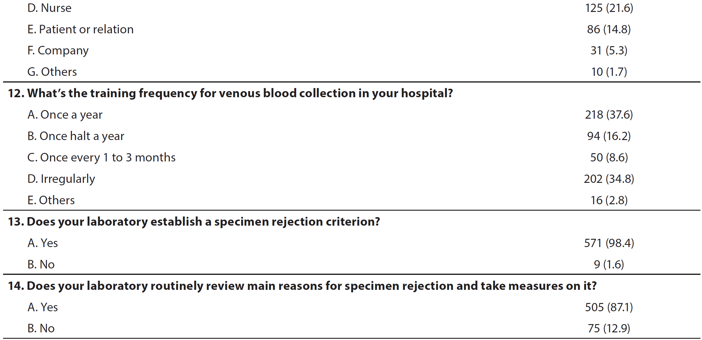
①
②
①
②

Slide 17
①
②
②
①

Slide 18
Results
Table 2 illustrates the specimen rejection rate according to Lab characteristics/practices, including:
hospital grade, bed size, ISO 15189/CAP accreditation,
training frequency for phlebotomy personnel,
specimen rejection criteria, and
periodically reviewed main reasons for rejection and take measures

Slide 20
Table 3 compares % of collected & rejected specimens according to specimen characteristics
87% of rejection specimens were from inpatient department, with a rejection rate of 0.19%

Slide 21
Table 3 compares continued …

Slide 22
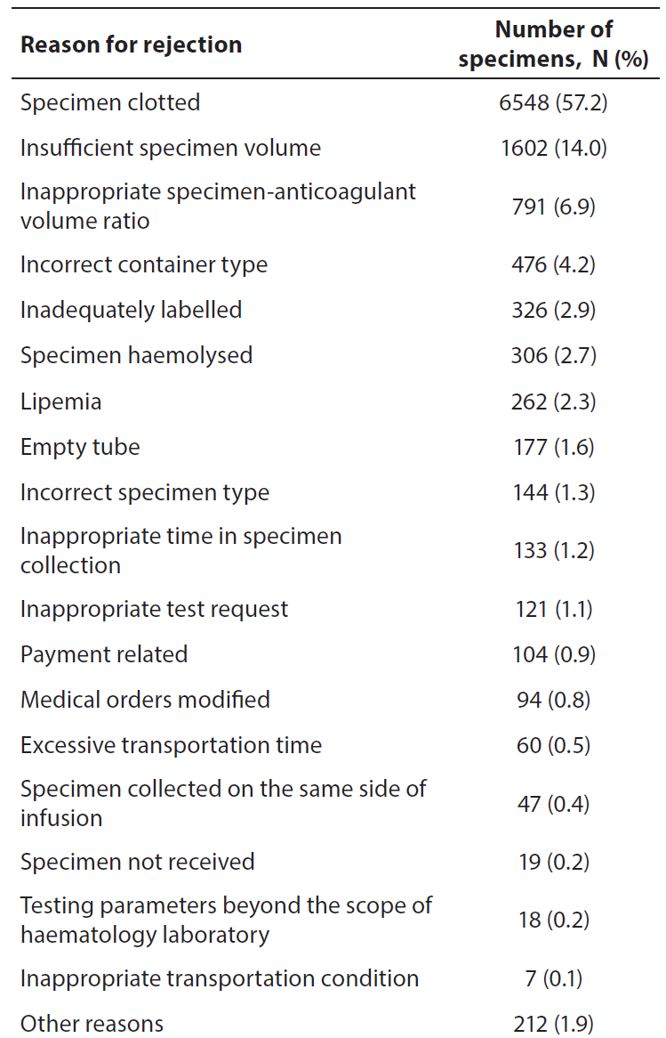
Results
Table 4 illustrates the distribution of rejected specimens, based on reasons for rejection
~85% of rejections attributed to 5 reasons:
specimen clotted (57%),
insufficient specimen volume (14%),
inappropriate specimen anticoagulant volume ratio (6.9%),
incorrect container type (4.2%)
inadequately labelled (2.9%)

Slide 23
Discussion
The rejection rate in the study was similar to, but slightly lower than that found in the previous CBC testing study in 2012 (11).
11. Zhang L, Yang X, Wang W, Wang ZG. National survey on specimen acceptability for CBC testing of clinical laboratories in China. Int J Lab Hematol. 2016;38:e48-e51.
The comparison → laboratories in China pay more attention to collection and reception of specimens in the past 5 years ⇒ a ↓ in rejection due to preanalytical errors.

Slide 24
Discussion
Compared with the study by CAP and in Spain → the overall rejection rate in this study was much lower (3,5,7)
3. Jones BA, Calam RR, Howanitz PJ. Chemistry specimen acceptability: A College of American Pathologists Q-Probes Study of 453 Laboratories. Arch Pathol Lab Med.26-121:19;197.
5. Jones BA, Meier F, Howanitz PJ. CBC specimen acceptability: A College of American Pathologists Q-Probes Study of 703 Laboratories. Arch Pathol Lab Med.8-119:203;1995.
7. Alsina MJ, Alvarez V, Barba N, Bullich S, Cortes M, Escoda I, Martinez-Bru C. Preanalytical quality control program - an overview of results (2001-2005 summary). Clin Chem Lab Med. 2008;46:849-54.

Slide 25
Discussion
The most common rejection reason was clotted specimen  occurred 4 times > the second most common reason for rejection (insufficient specimen volume)
The result was similar to the study of hematology specimen acceptability conducted by CAP (5).
5. Jones BA, Meier F, Howanitz PJ. CBC specimen acceptability: A College of American Pathologists Q-Probes Study of 703 Laboratories. Arch Pathol Lab Med.8-119:203;1995.
Since the predominance of clotted specimens → participants were suggested to have an investigation for reasons for that. For example, the blood collection procedure and the mixing procedure of collection tube ⇒ ↓ occurrence of clotted specimen.

Slide 26
Discussion
Transportation method and phlebotomy personnel  were important influence factors for specimen acceptability.
Specimens transported by Lab personnel and specimens collected by Lab personnel and nurse managed by Lab exhibited a much lower rejection rate.
It possibly because Lab personnel had a better knowledge of the influence factors of specimen and had a better practice on specimen collection and transportation.

Slide 27
Discussion
The common consequences of specimen rejection were  the need to recollect a new specimen ⇒ delay in examination & reporting
The outcomes of specimen recollection and delay in reporting  led to patient complaint and dissatisfaction and postponed the diagnosis and treatment for the patient.
However, there was certain limitation in the study.
Participants were asked to register all the information of rejected specimens → which was hard to complete.

Slide 28
Discussion
In summary,
the management of unacceptable specimens in China needs to be improved.
The criteria for specimen rejection and judgment method for unacceptable specimens → need to be harmonized.
Specimen rejection rate is an important indicator for quality monitoring in preanalytical phase.
Laboratories should regularly review the monthly specimen rejection rate and related influence factor  and take effective actions.

Slide 29
Thanks for your attention

