Slide 1
بنام خدا
Sigmametric
Asad Vaisi-Raygani, PhD,
Professor of Clinical Biochemistry,
School of Medicine, Kermanshah University of Medical Sciences, Daneshgah Ave, P.O. Box 6714869914,Kermanshah, IRAN.
email: avaisirayganii@gmail.com;
http://orcid.org/0000-0002-3042-2832
Scopus Author ID: 14623384500

Slide 2

Sigmametric

Slide 3


Slide 4
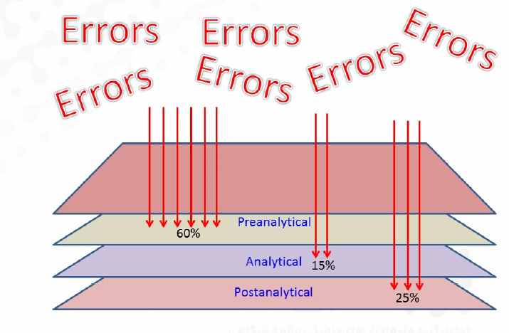

Slide 5
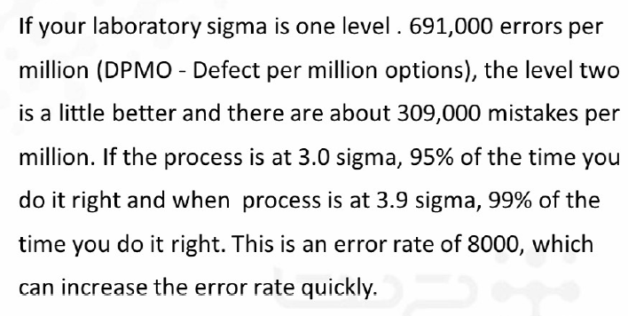
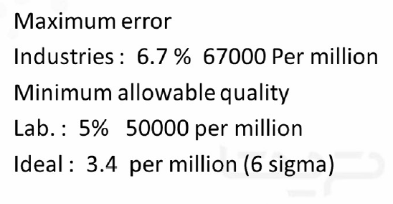

Slide 6
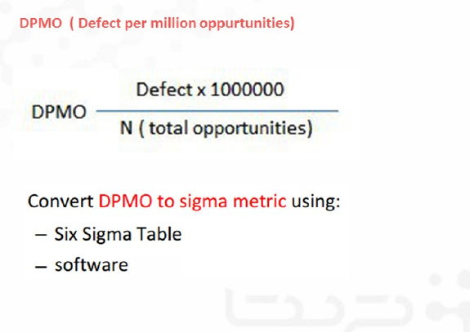

Slide 7
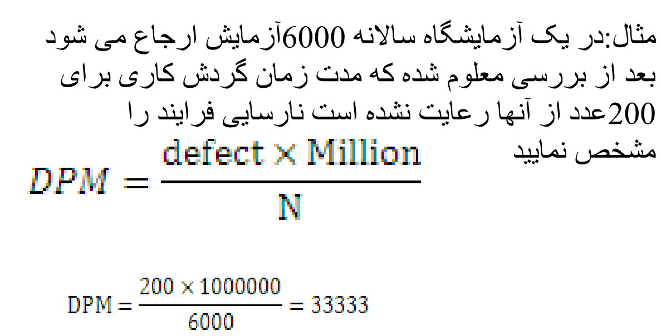

Slide 8
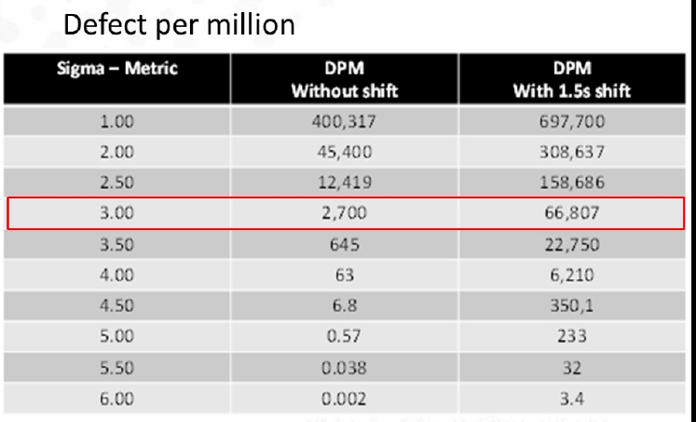

Slide 9
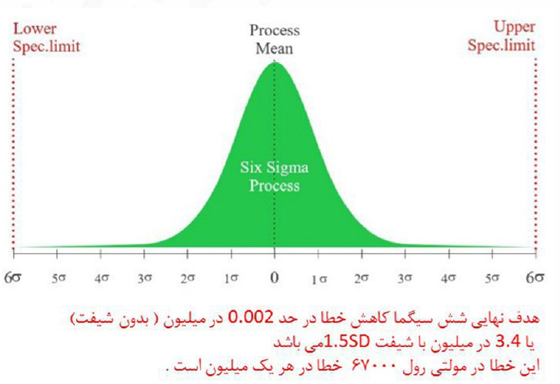

Slide 10
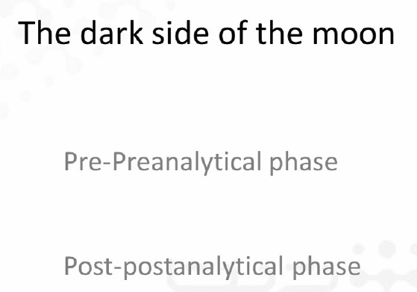

Slide 11
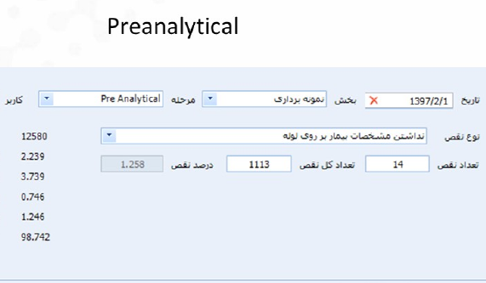

Slide 12
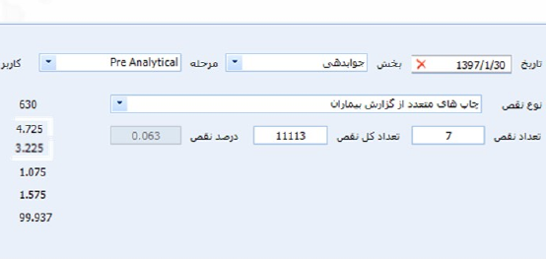

Slide 13
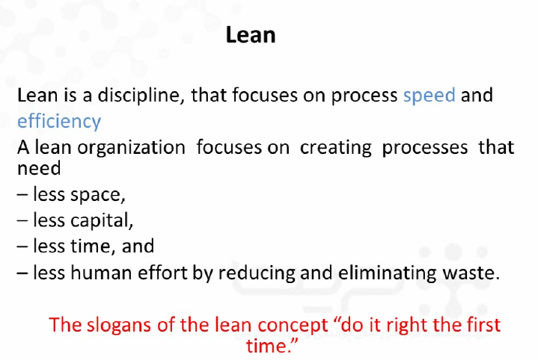
فضای کمتری
سرمایه کمتری
شعار

Slide 14
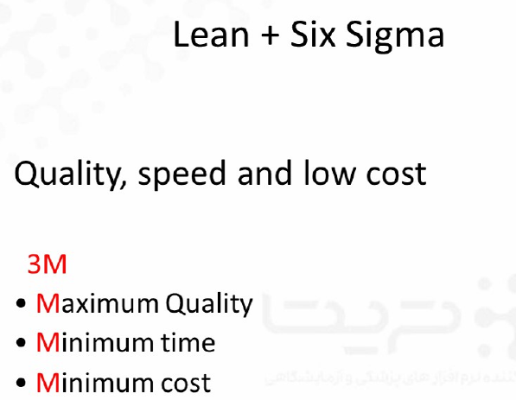

Slide 15
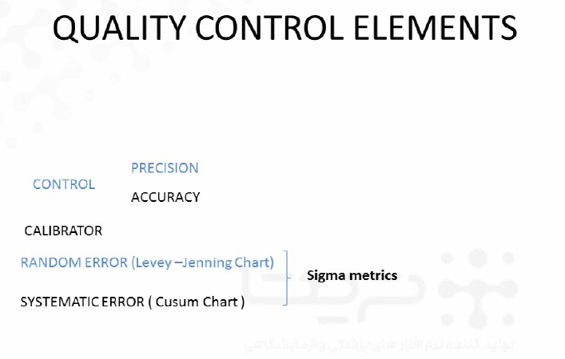

Slide 16
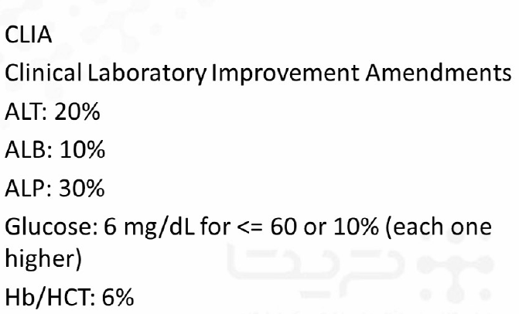

Slide 17
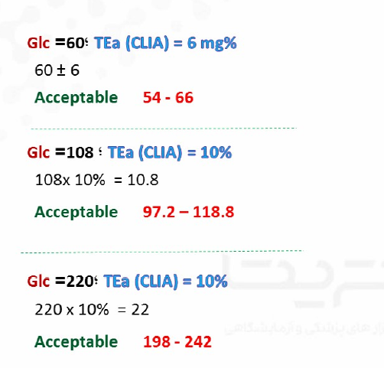

Slide 18
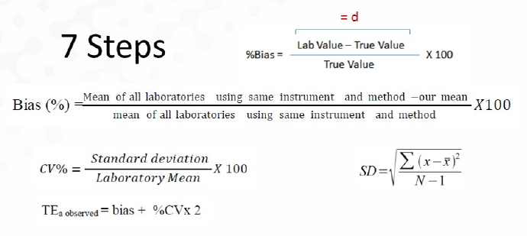

Slide 19
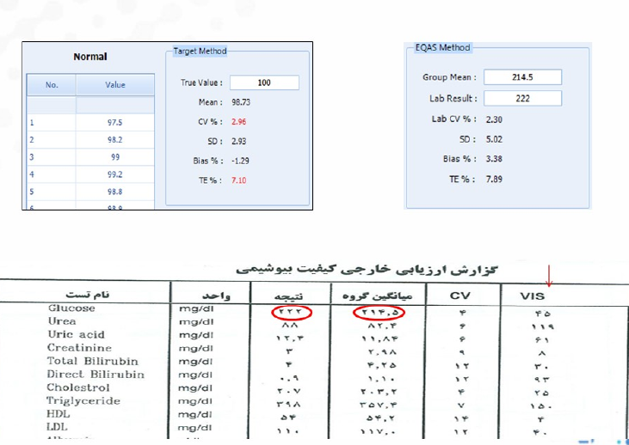

Slide 20
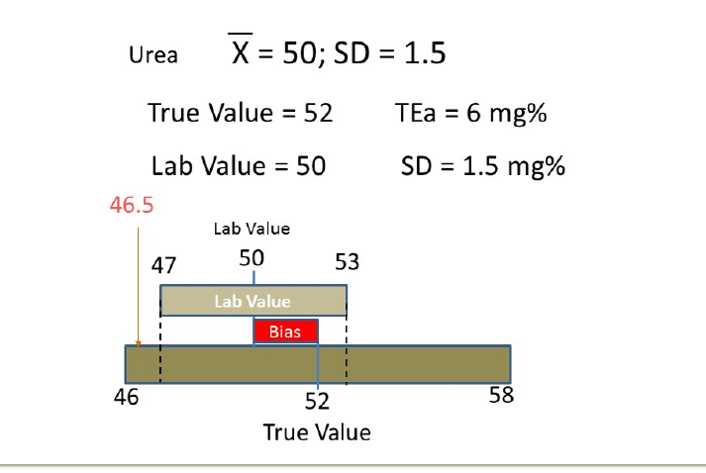
Bias= (52-50)/52x100=4 , TE= Bias+2xCV=4+5/8=9/8
CV=SD/Mean x100=1/5/50 x 100=2/9 TE>TEa unacceptable

Slide 21
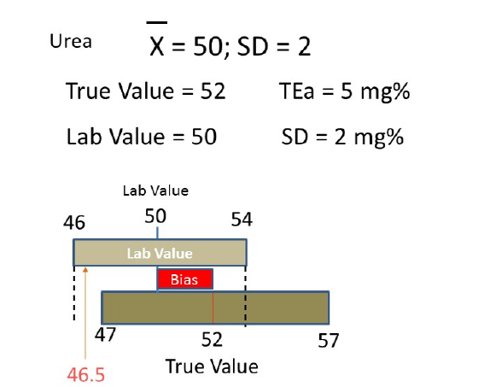
Bias= (52-50)/52x100=3/8 , TE= Bias+2xCV=3/8+8=11/8
CV=SD/Mean x100=2/50 x 100=4 TE>TEa

Slide 22
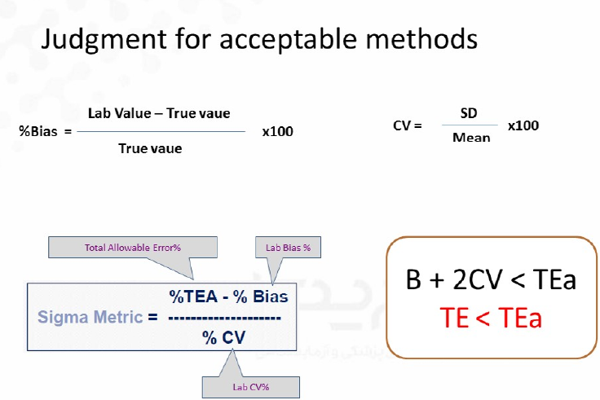

Slide 23
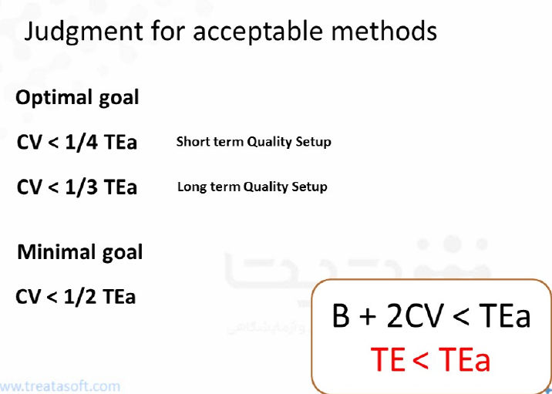

Slide 24
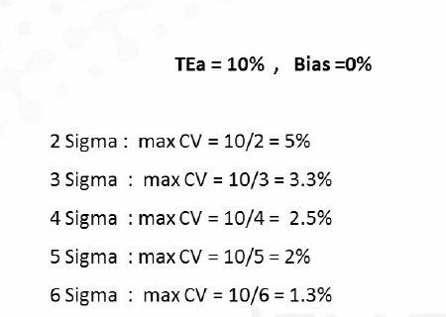

Slide 25
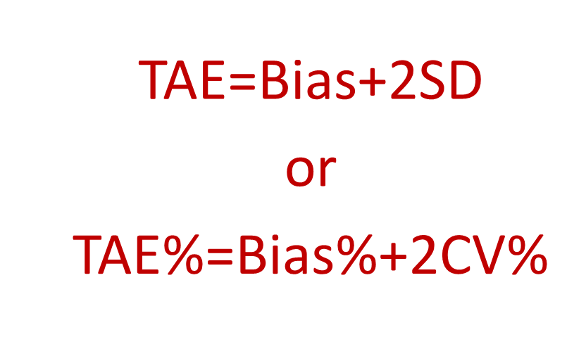

Slide 26


Slide 27
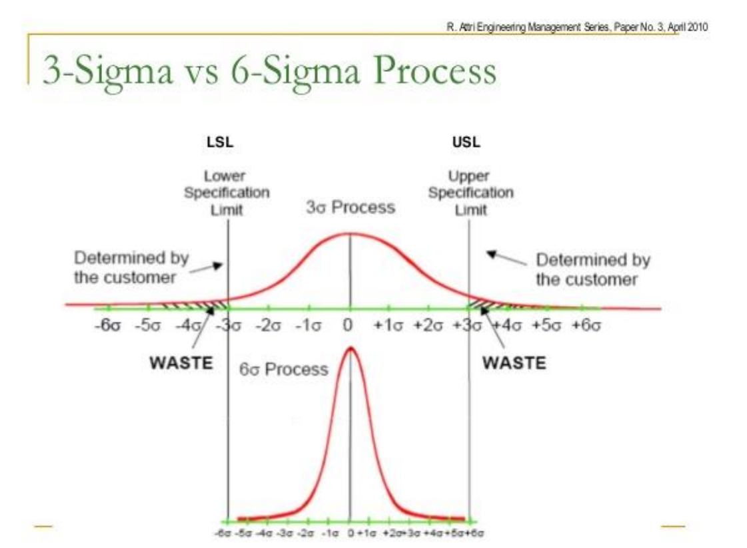

Slide 28
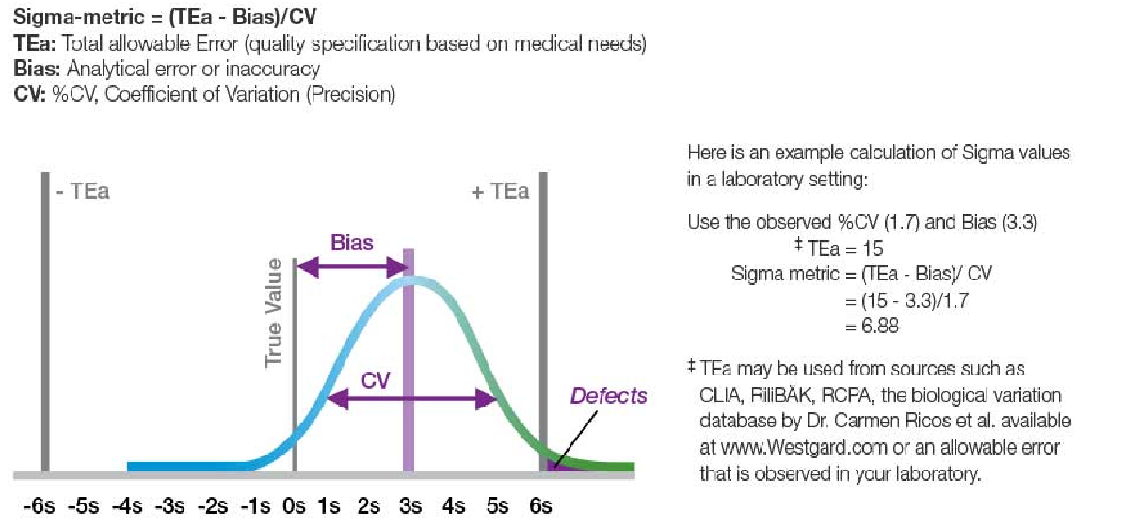

Slide 29
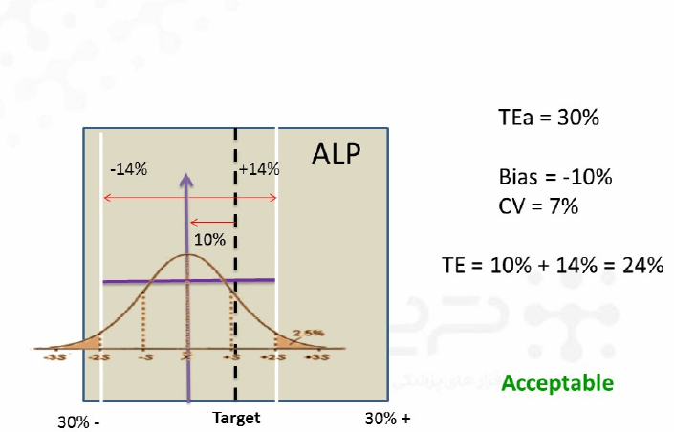
Bias+2CV=TE
TE<TEa

Slide 30
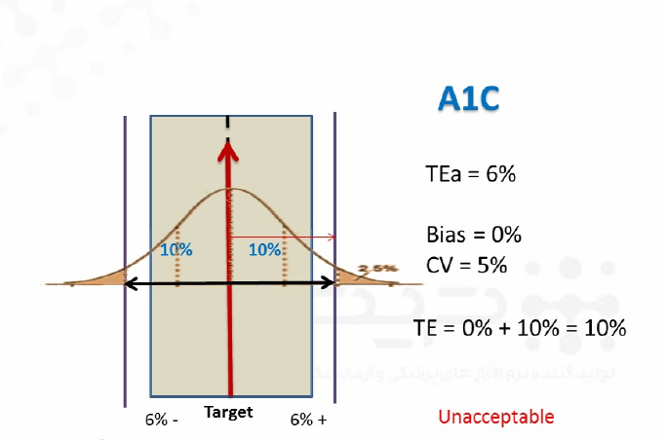
TE>TEa

Slide 31
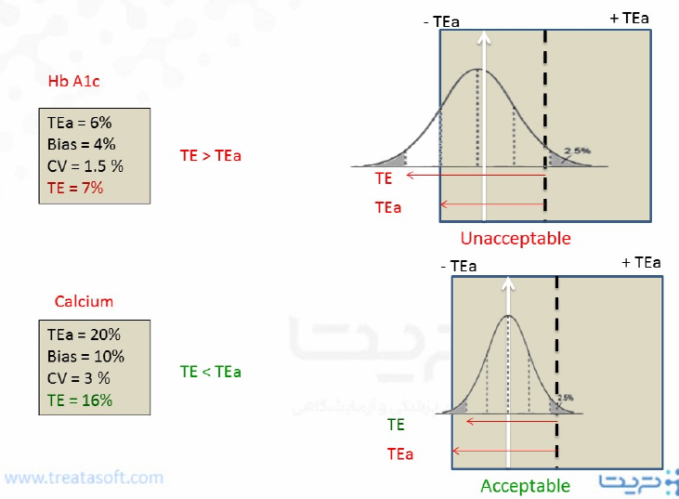

Slide 32
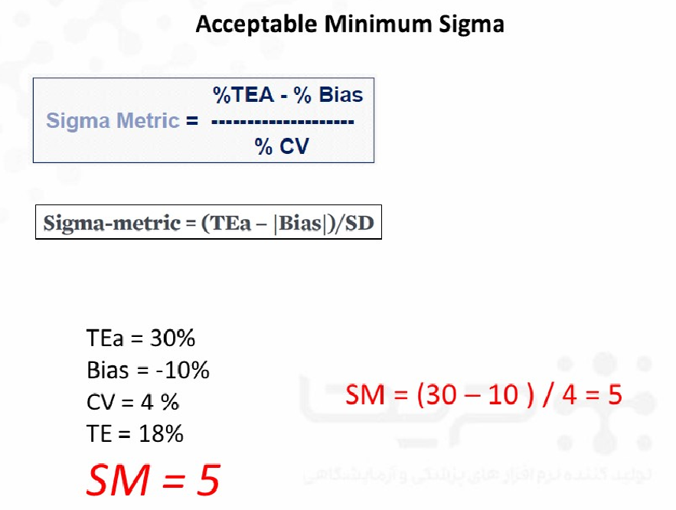

Slide 33
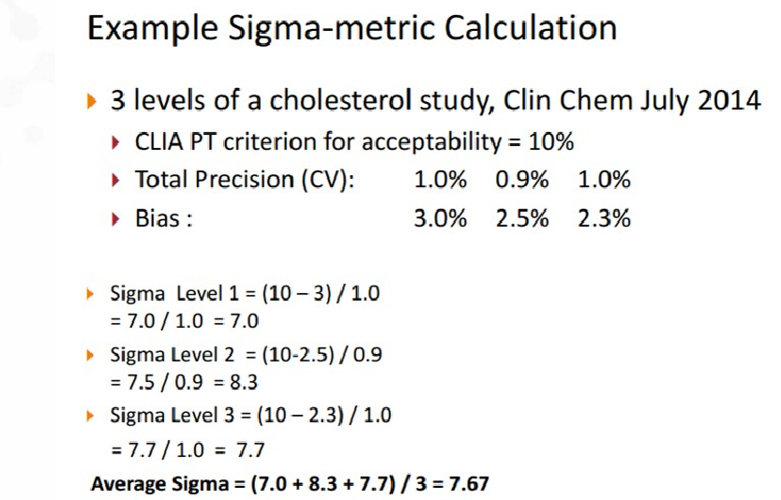

Slide 34
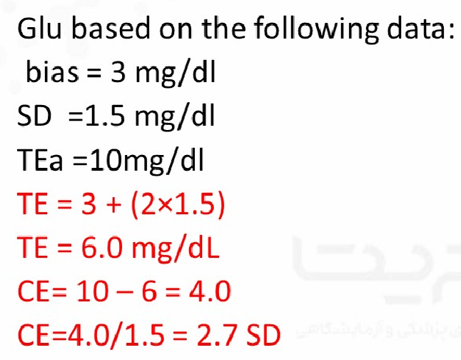

Slide 35
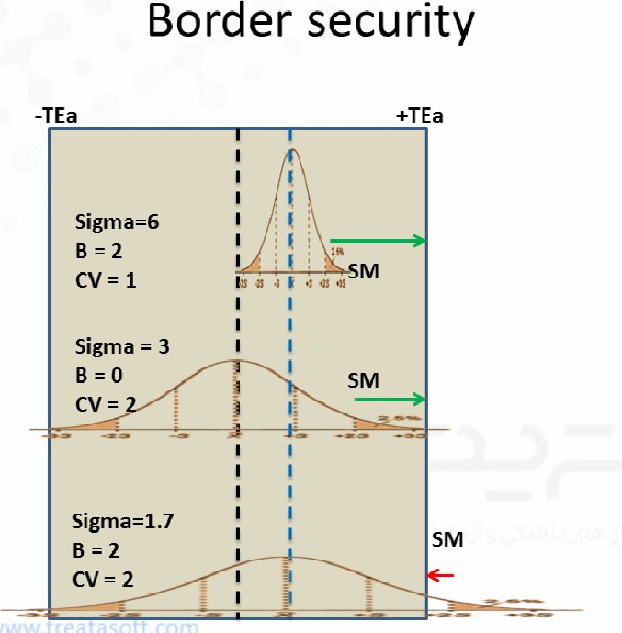

Slide 36
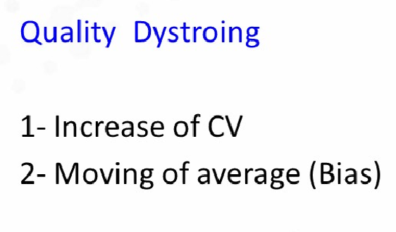


Slide 37
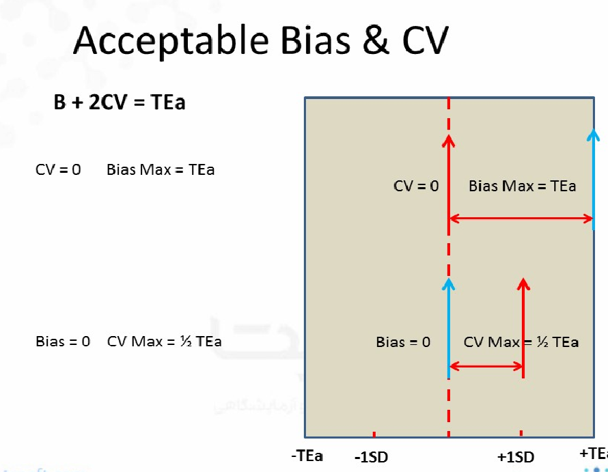

Slide 38
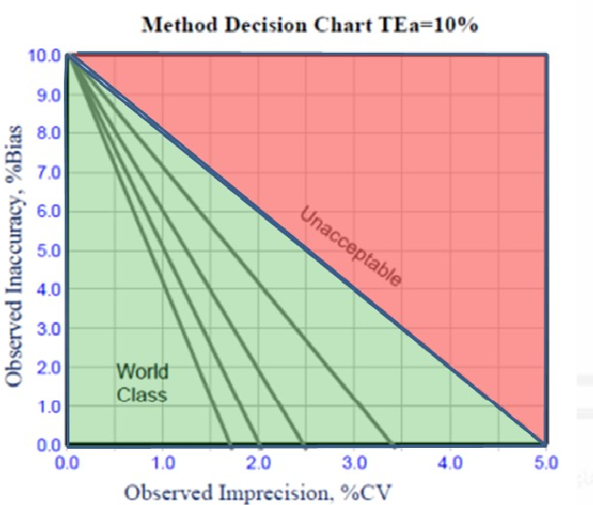

Slide 39
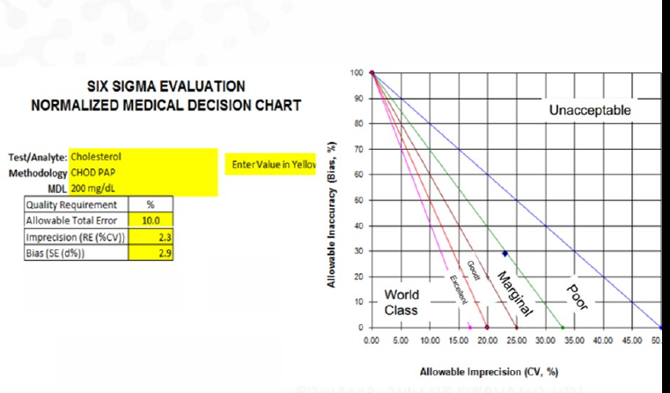

Slide 40
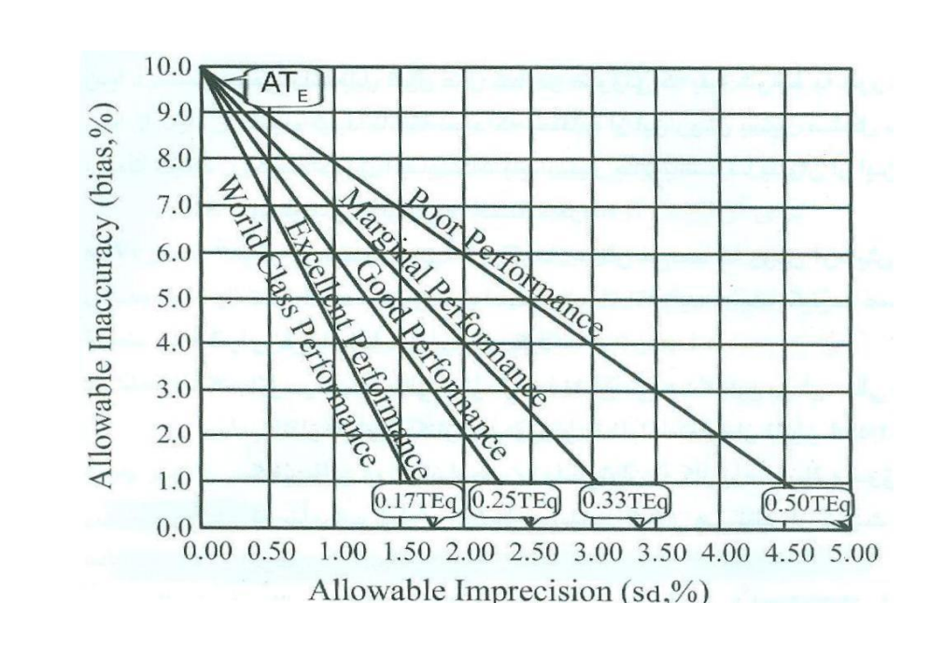

Slide 41
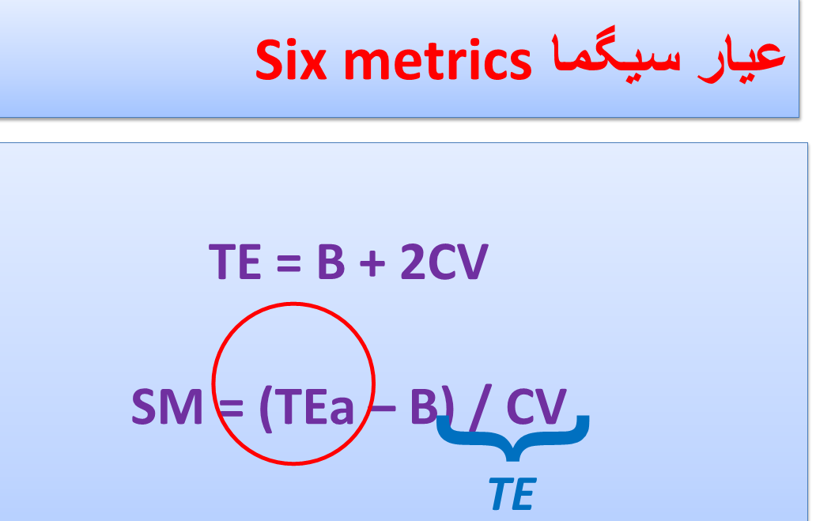

Slide 42
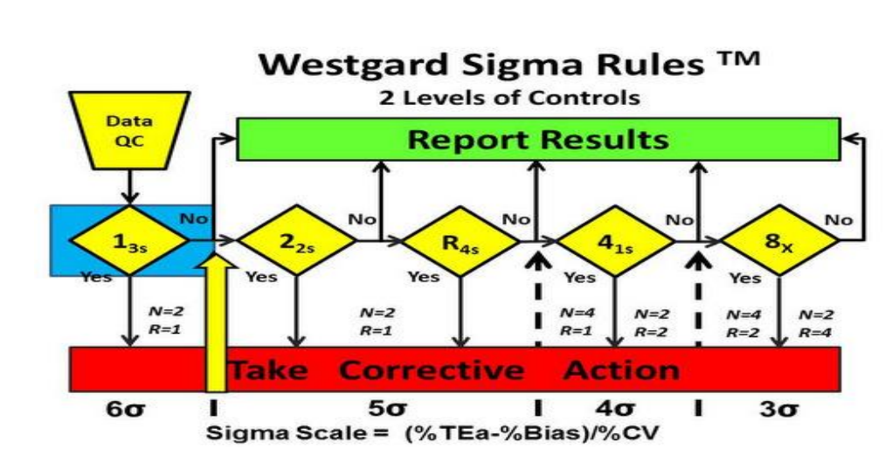
6-sigma quality requires only a single control rule, 13s, with 2 control measurements in each run one on each level of control). The notation N=2 R=1 indicates that 2 control measurements are needed in a single run.

Slide 43
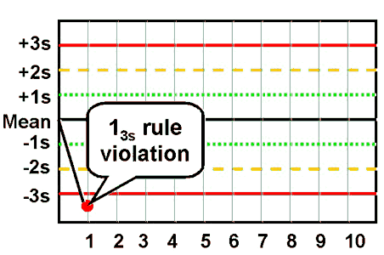
1_{3S} : Rejection Random error

Slide 44
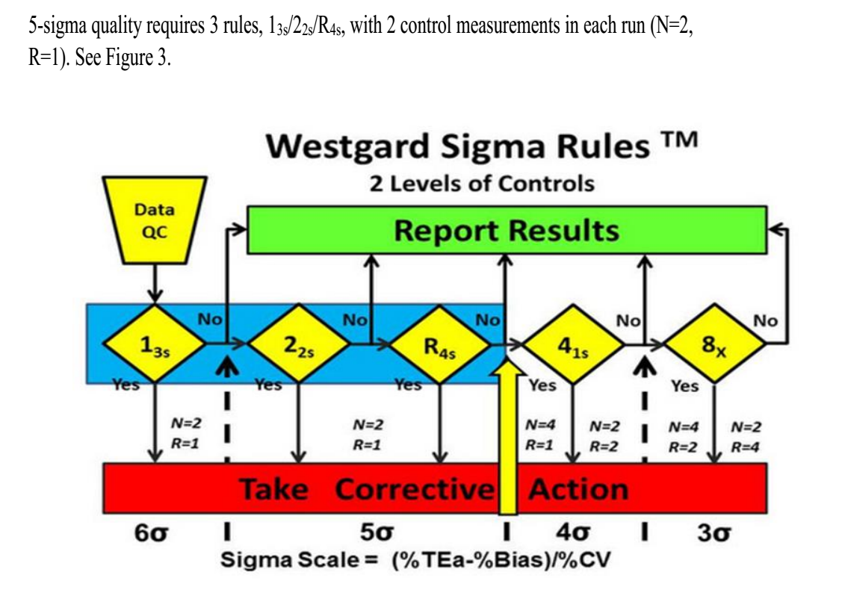
5-sigma quality requires 3 rules, 13s/22s/R4s, with 2 control measurements in each run (N=2,
R=1). See Figure 3.

Slide 45
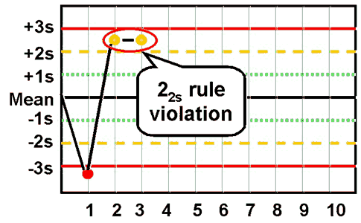
2_{2s} : Rejection systematic error

Slide 46
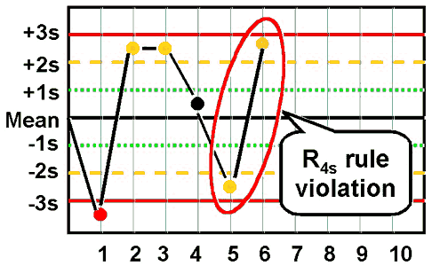
R_{4s} : Rejection random error

Slide 47
4-sigma quality requires addition of a 4th rule and implementation of a 13s/22s/R4s/41s multirole,
preferably with 4 control measurements in each run (N=4, R=1), or alternatively, 2 control
measurements in each of 2 runs (N=2, R=2), using the 41s rule to inspect the control rules across
both runs. This 2nd option suggests dividing a day’s work into 2 runs and monitoring each with 2 controls.

Slide 48
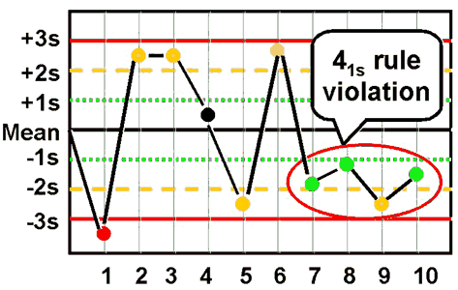
Rejection systematic error

Slide 49
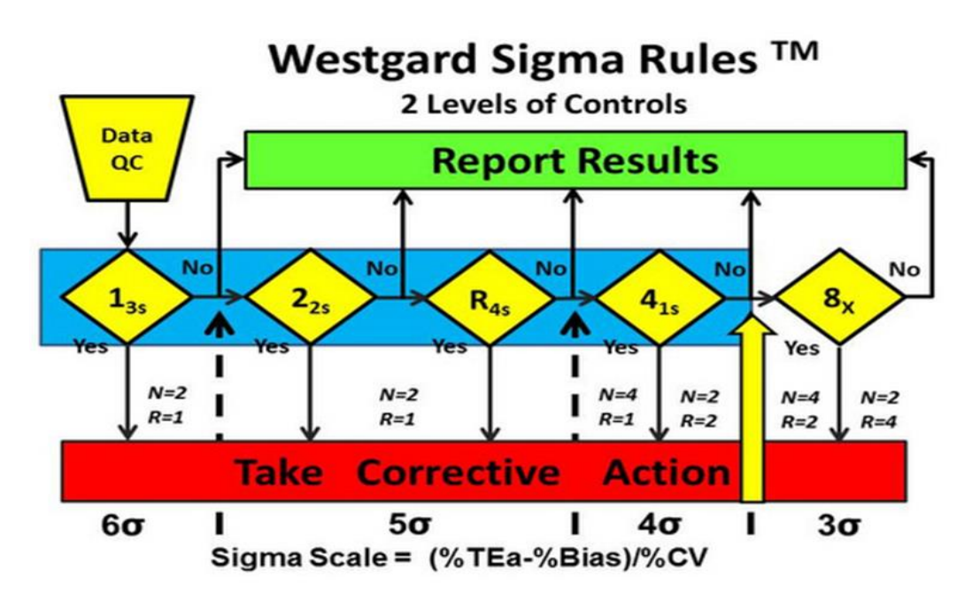

Slide 50
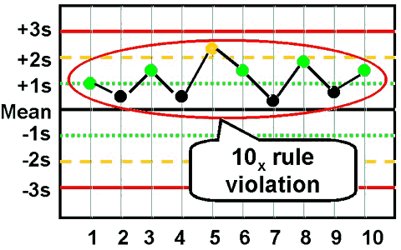
Rejection systematic error

Slide 51
<4-sigma quality requires a multirule procedure that includes the 8x rule, which can be
implemented with 4 control measurements in each of 2 runs (N=4, R=2) or alternatively with 2
control measurements in each of 4 runs (N=2, R=4). The first option suggests dividing a days’
work into 2 runs with 4 control measurements per run, whereas the second option suggests
dividing a day’s work into 4 runs and monitoring each with 2 controls. See Figure 5.

Slide 52
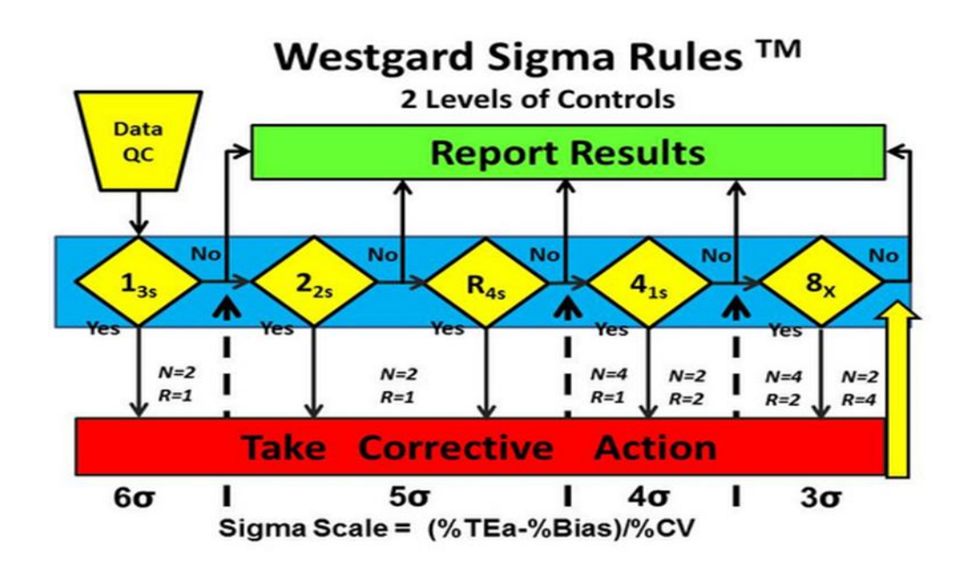

Slide 53
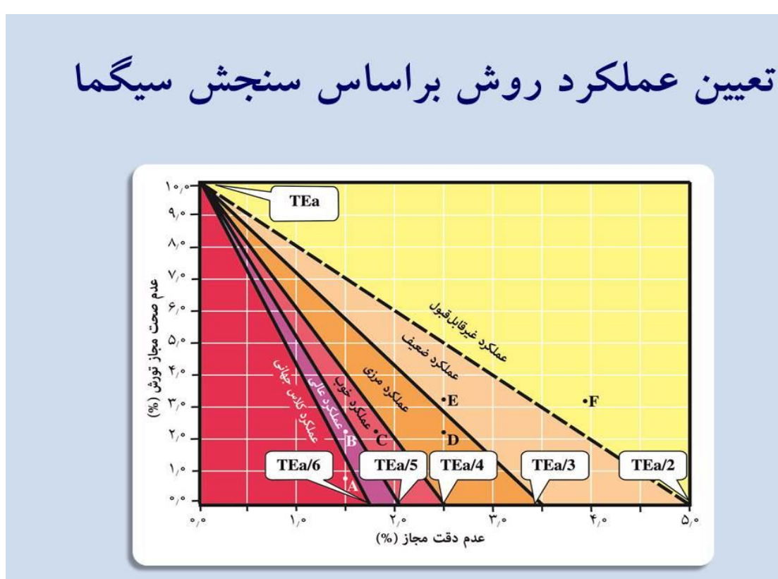

Slide 54
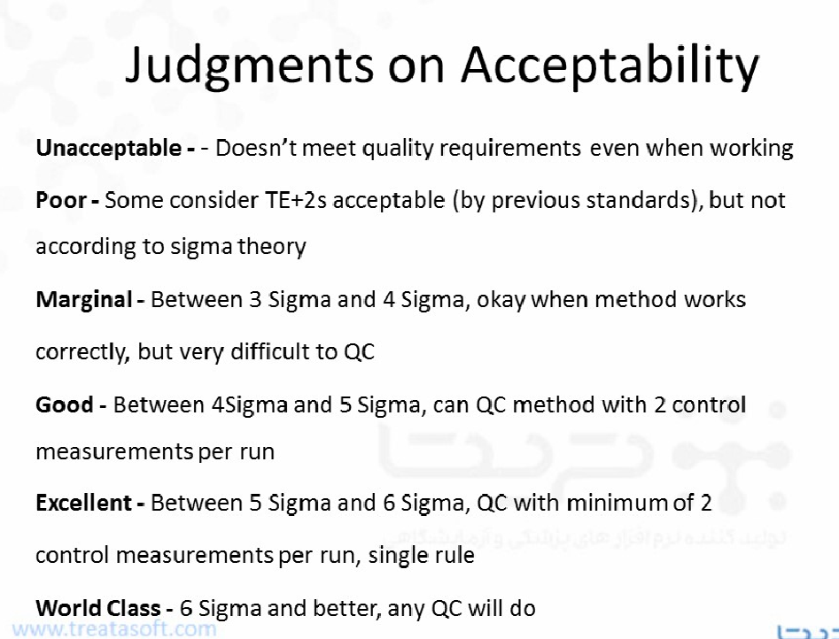

Slide 55
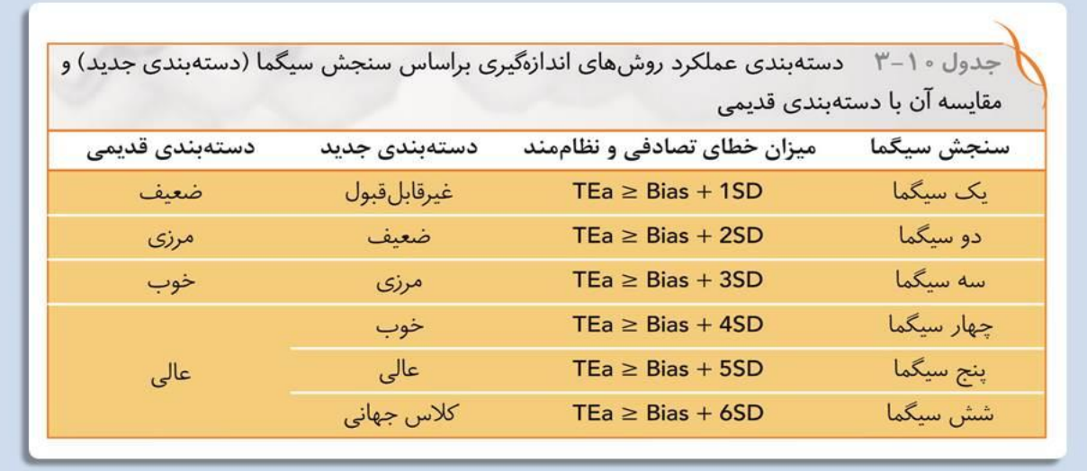

Slide 56


Slide 57


Slide 58


